Slide 1

- By Rohan Bhandari

Slide 2
Agenda
Introduction to Kafka
What is Messaging system?
Why Kafka?
Features of Kafka
Components
Types of Clusters
Kafka API’s
Workflow of Messaging
Commands
Demo

Slide 3
Introduction
Apache Kafka is an open-source stream-processing software platform which is used to handle the real-time data storage.
Stores streams of records in a fault-tolerant durable way.
Processes streams of records as they occur.
Written in Scala and Java
Was first originated at LinkedIn
Later it became an open sourced Apache project in 2011

Slide 4
What is Messaging System?
Responsible for transferring data from one application to another
Point – to – Point Messaging System
Publish Subscribe Messaging System

Slide 5
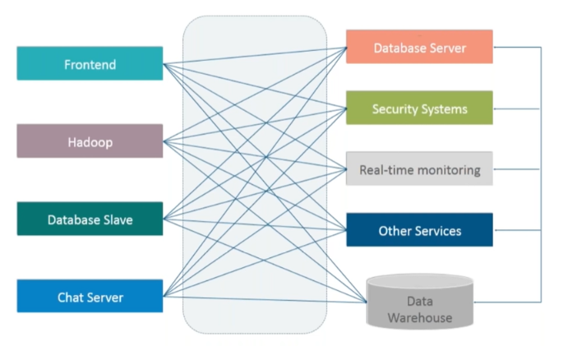
Why Kafka?
Apache Kafka is a distributed publish-subscribe messaging system and a robust queue that can handle a huge volume of data
Enables you to pass messages from one end-point to another.
Kafka is suitable for both offline and online message consumption.

Slide 6
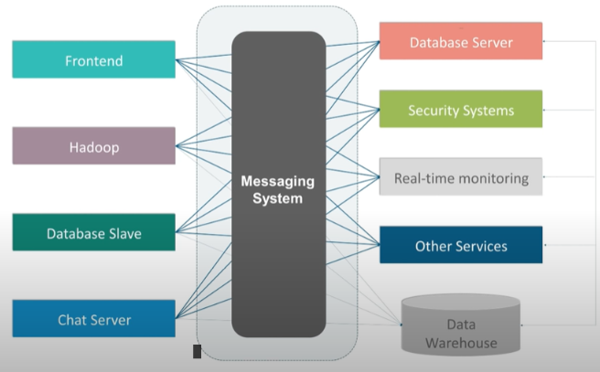
Why Kafka? Contd..
Kafka messages are persisted on the disk and replicated within the cluster to prevent data loss.
Kafka is built on top of the Zookeeper synchronization service.
It integrates very well with Apache Storm and Spark for real-time streaming data analysis

Slide 7
Features of Kafka
Reliability
Durability
Scalability
Performance

Slide 8
Kafka Use Cases
Message service
Real-time stream processing
Log aggregation
Event sourcing

Slide 9
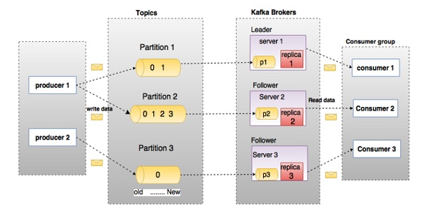
Components of Kafka
Topics
Partition
Partition offset
Brokers
Kafka Cluster

Slide 10
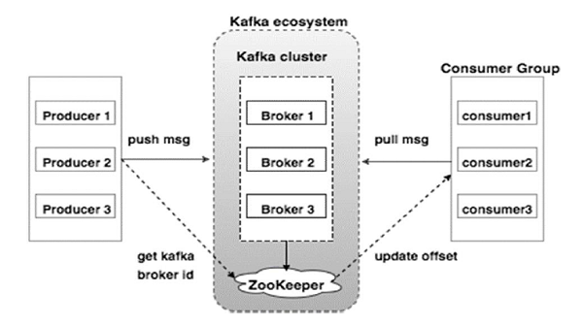
Components Contd..
Zookeeper
Producers
Consumers

Slide 11
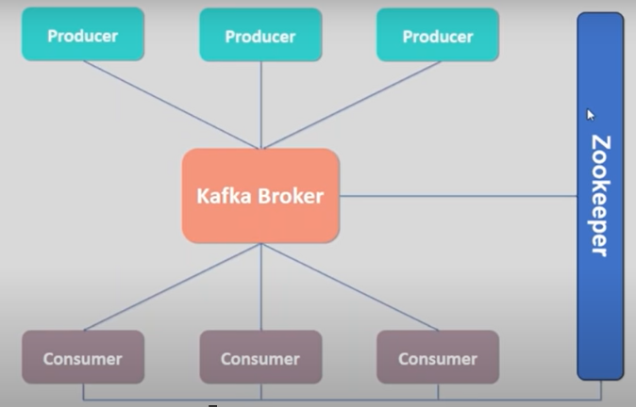
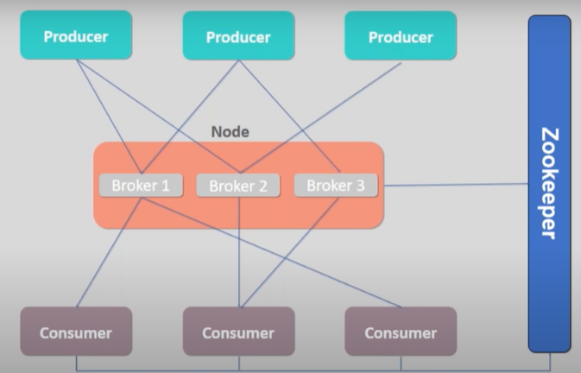
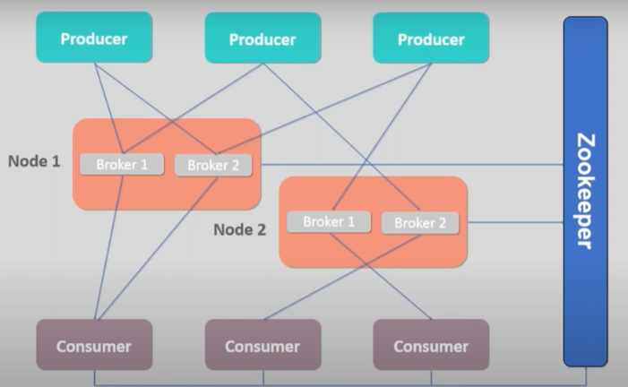
Types of Clusters
Single Node – Single Broker
Single Node – Multiple Broker
Multiple Nodes – Multiple Brokers

Slide 12
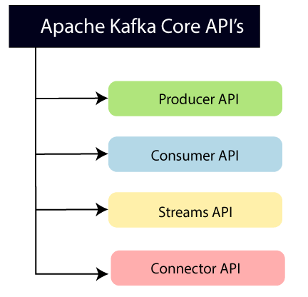
Kafka API’s

Slide 13
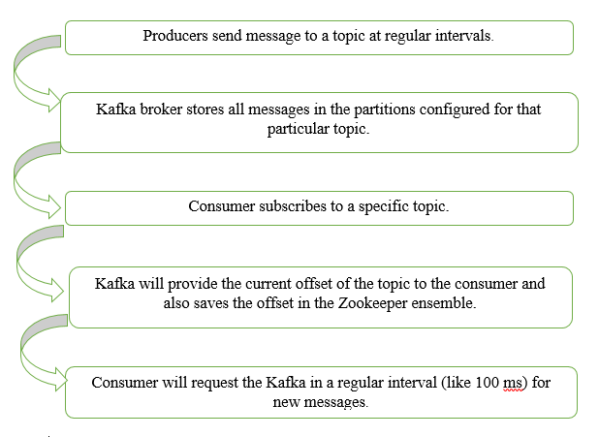
Workflow of Messaging

Slide 14
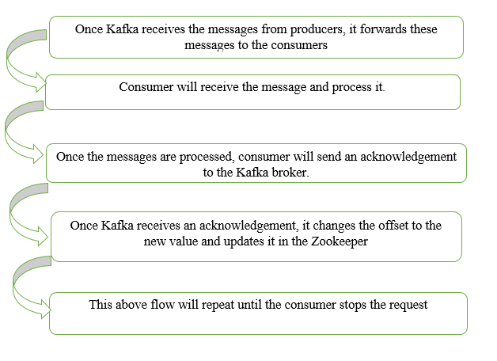
Work Flow Contd.

Slide 15
Basic Commands
Prerequisites:
Apache Kafka Installed
Java 8 Installed
Commands to start Zookeeper and Kafka Service
.\bin\windows\zookeeper-server-start.bat .\config\zookeeper.properties
.\bin\windows\kafka-server-start.bat .\config\server.properties

Slide 16
Features of Kafka
To create a topic:
.\bin\windows\kafka-topics.bat --zookeeper localhost:2181 --replication-factor 1 --partitions 1 --create --topic test1
To list the available topics:
.\bin\windows\kafka-topics.bat --zookeeper localhost:2181 --list
To describe a topic:
.\bin\windows\kafka-topics.bat –describe --zookeeper localhost:2181 –topic test1

Slide 17
Features of Kafka
To start Producer:
.\bin\windows\kafka-console-producer.bat --broker-list localhost:9092 --topic test1
To start consumer:
.\bin\windows\kafka-console-consumer.bat --bootstrap-server localhost:9092 --topic bearcat-messages --from-beginning
To alter a topic:
.\bin\windows\kafka-topics.bat --zookeeper localhost:2181 --alter –topic test1 –partitions 3

Slide 18
Demo

Slide 19
Questions?

Slide 20
References
https://github.com/denisecase/kafka-api
https://www.tutorialspoint.com/apache_kafka/index.htm
https://www.javatpoint.com/apache-kafka

Slide 21
Thank You..!

